Slide 1
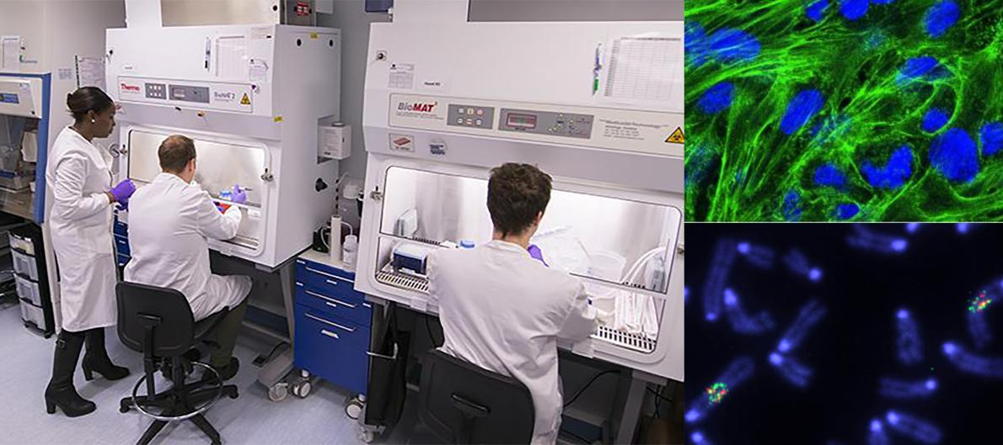
MB PhD (and BDS PhD) OPPORTUNITY 2024
In 2024, we expect to have up to 4 funded PhD positions available for highly motivated University of Edinburgh or University of Glasgow MBChB students on completion of their intercalated BMedSci.
The CRUK TRACC programme has been designed to help develop the future leaders in cancer research by providing an early route to an academic career for highly promising students. Successful candidates will be closely mentored by senior academic staff, will be placed into top research laboratories of their choice (in Edinburgh or Glasgow and across both Universities) and will complete a 3-year PhD before returning to the fourth year of their MBChB course. A full stipend and generous research consumables package (including funds ringfenced for personal development) will be provided.
Who is eligible to apply? (i) MBChB students from either University currently in their intercalated BMedSci year (2023-2024); (ii) postgraduate students currently in 2nd year (Edinburgh) or 3rd year (Glasgow) who previously graduated with a BSc; and (iii) Glasgow BDS students currently in their intercalated BMedSci year or who previously graduated with a BSc
More information can be found on:
TRACC (Edinburgh Cancer Research) website: https://www.ed.ac.uk/cancer-centre/graduate-research-and-training/tracc-programme-for-clinicians/tracc-programme-mb-phd
TRACC (CRUK Scotland Centre) website: https://www.crukscotlandcentre.ac.uk/training/tracc-programme-for-clinicians
Key contacts: For friendly informal advice or to express interest please contact:
TRACC Programme
(cancer research)
Dr Farhat Din, Edinburgh traccadminedinburgh@mlist.is.ed.ac.uk
Prof Richard Wilson, Glasgow richard.h.wilson@glasgow.ac.uk
Application deadline: 2 April 2024
Expected interview date: 7 May 2024

